Slide 1
Dataset Arrays: Part II

Slide 2
BIG DATA
A few of the many applications for analyzing large sets of Data:
Predicting Catastrophic Weather early enough to allow safe evacuation or preparation.
Monitoring Customer Buying Habits.
DNA Analysis to predict, prevent, treat, or minimize medical problems
Searching for other planets in the universe that may harbor life.
National Security.
90% of the data that exists today was generated in the last 2 years!

Slide 3
Statistical Analysis and Data Presentation for a Dataset Array on CVG Flight Data

Slide 4
Flight Data
Shown here is a portion of an excel file containing flight data out of the CVG airport from 11/22/2013 thru 11/30/2013. (Thanksgiving: 11/28/2013)
Carrier | Date | FlightNumber | Destination | Depart | Delay
DL | 11/22/2013 | 186 | BOS | 16:00 | 71
DL | 11/22/2013 | 330 | ATL | 12:05 | -1
DL | 11/22/2013 | 523 | RSW | 09:40 | -5
DL | 11/22/2013 | 803 | MCO | 09:30 | -4
DL | 11/22/2013 | 1,143 | ATL | 08:25 | -3
DL | 11/22/2013 | 1,303 | MCO | 11:50 | -10
DL | 11/22/2013 | 1,345 | FLL | 11:35 | 1
DL | 11/22/2013 | 1,349 | ATL | 18:00 | -5
DL | 11/22/2013 | 1,520 | ATL | 10:00 | -6
DL | 11/22/2013 | 1,639 | TPA | 11:30 | -2
DL | 11/22/2013 | 1,741 | SLC | 08:30 | -1
DL | 11/22/2013 | 1,807 | SEA | 09:30 | -8
DL | 11/22/2013 | 1,833 | LAX | 16:10 | -13
DL | 11/22/2013 | 1,881 | ATL | 16:00 | 3
Excel File: CVG_FLIGHTS.xls

Slide 5
Flight Data
Carrier is the airline:
Delta (DL),
ExpressJet (E*)
American Eagle (MQ)
Frontier (F9)
Mesa Airlines (YV)
Pinnacle (9E)
Depart is the scheduled departure time following the 24 hr military clock; that is, 11:15 means 11:15 a.m. and 16:10 means 4:10 p.m.
Delay is given in minutes. Negative means the flight left earlier than scheduled.
Destination is the code for the destination airport.
Source: http://www.bts.gov/xml/ontimesummarystatistics/src/index.xml
Destination is the code for Destination Airport

Slide 6
Import Flight Data as Dataset Array
>> F = dataset('xlsfile','CVG_FLIGHTS');
>> F(1:5,:) % Display First 5 rows of the dataset
ans =
Carrier Date FlightNumber Destination Depart Delay
'DL' '11/22/2013' 186 'BOS' '16:00' 71
'DL' '11/22/2013' 330 'ATL' '12:05' -1
'DL' '11/22/2013' 523 'RSW' '09:40' -5
'DL' '11/22/2013' 803 'MCO' '09:30' -4
'DL' '11/22/2013' 1143 'ATL' '08:25' -3
Note: F.Delay and F.FlightNumber are column vectors of numbers
F.Carrier, F.Date, F.Destination, and F.Depart are cell arrays of strings

Slide 7
Longest Delay
Find and display the flight information for the longest delay(s).
>> longest = max(F.Delay)
longest = 556
>> loc_longest = find(F.Delay == longest)
loc_longest = 80
>> F(loc_longest,:)
ans =
Carrier Date FlightNumber Destination Depart Delay
'DL' '11/26/2013' 1520 'ATL' '10:00' 556

Slide 8
Longest Delay
How many flights left the day before Thanksgiving (11/27/2013) and what was the longest delay time?
>> Nov27 = find(strcmp(F.Date,'11/27/2013'));
>> Num_Flights = length(Nov27)
Num_Flights =
107
>> max(F.Delay(Nov27))
ans =
187

Slide 9
Shortest Delay
Find and display the flight information for the shortest delays.
>> loc_shortest = find(F.Delay == min(F.Delay))
loc_shortest = 257
>> F(loc_shortest,:)
ans =
Carrier Date FlightNumber Destination Depart Delay
'MQ' '11/30/2013' 2943 'DFW' '10:45' -17

Slide 10
Delay vs. Departure Time
Create a group scatter plot (grouped by airline) of delay time (y-axis) vs. scheduled departure time (hour).
Problem: Departure Time is a string – how do we extract the hour?
>> datevec(F.Depart(1:5))
ans =
2014 1 1 16 0 0
2014 1 1 12 5 0
2014 1 1 9 40 0
2014 1 1 9 30 0
2014 1 1 8 25 0
Datevec produces an matrix with year in the 1st column, followed by month, day, hour, minutes, and seconds.
Year/Month/Day defaults to Jan, 1, CurrentYear if data not provided. Hours/Min/Seconds all default to zero if data not provided.

Slide 11
Delay vs. Departure Time
Use datevec to add a column to the dataset array with hour of scheduled departure.
>> Time = datevec(F.Depart);
>> F.HOUR = Time(:,4);
Carrier Date FlightNumber Destination Depart Delay HOUR
'DL' '11/22/2013' 186 'BOS' '16:00' 71 16
'DL' '11/22/2013' 330 'ATL' '12:05' -1 12
'DL' '11/22/2013' 523 'RSW' '09:40' -5 9
'DL' '11/22/2013' 803 'MCO' '09:30' -4 9
'DL' '11/22/2013' 1143 'ATL' '08:25' -3 8

Slide 12
Delay vs. Departure Time
>> gscatter(F.HOUR,F.Delay,F.Carrier); ylim([-20,600])
Question: Notice any trends here?

Slide 13
Mean and Standard Deviation
Find the mean delay time and the standard deviation for all of the flights.
>> avg = mean(F.Delay)
avg =
6.1878 % minutes
>> dev = std(F.Delay)
dev =
36.9508 % minutes

Slide 14
Individual Airline Data
Method 1: Use MATLAB Commands
>> delta = find(strcmp(F.Carrier,'DL')); % Delta Rows
>> length(delta)
ans = 159
>> avg_delta = mean(F.Delay(delta))
avg_delta = 4.5723
>> dev_delta = std(F.Delay(delta))
dev_delta = 45.7858
>> max_delta = max(F.Delay(delta))
max_delta = 556
>> min_delta = min(F.Delay(delta))
min_delta = -13

Slide 15
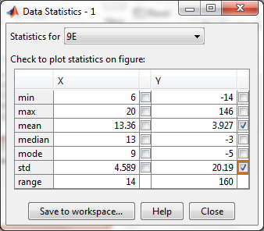
Individual Airline Data
Method 2: Pull Stats off scatter plot using Tools → Data Statistics

Slide 16
Individual Airline Data
Airline | Number of Flights | Longest Delay (min) | Shortest Delay (min) | Mean Delay (min) | Std. Dev. (min)
Delta (DL) | 159 | 556 | -13 | 4.6 | 45.8
Express Jet (E*) | 126 | 195 | -15 | 11.7 | 38.2
Frontier (F9) | 10 | 6 | -14 | -3.4 | 5.6
American Eagle (MQ) | 104 | 503 | -17 | 9.2 | 54.9
Mesa Airlines (YV) | 33 | 163 | -11 | 5.9 | 31.7
Pinnacle (9E) | 287 | 146 | -14 | 3.9 | 20.2

Slide 17
Common Error
Suppose we want to locate all of the Frontier flights that left on 11/23/13.
Don’t split the two conditions like this:
>> carrier_loc = find(strcmp(F.Carrier,'F9'))
carrier_loc =
390
391
392
393
394
395
396
397
398
399
>> rows = find(strcmp(F.Date(carrier_loc),'11/23/2013'))
rows =
2
3
The first command does indeed find all the rows with Frontier Flights
Rows 390 thru 399 in dataset , F.
The second command clearly isn’t giving the right rows in the dataset. Instead it is telling us which entries in vector, carrier_loc, point to the right rows in dataset. Don’t do this!

Slide 18
Common Error Fix
To find the correct rows in the dataset set, F, simply combine the conditions into one single command:
>> rows = find(strcmp(F.Carrier,'F9') & strcmp(F.Date,'11/23/2013'))
rows =
391
392
You can put any number of conditions within a single find statement and use the logical operators (&, |, ~ )

Slide 19
Pie Chart: Carrier Flight Distribution
Create a pie chart showing the percentage of flights from each airline departing during the time period 11/22/2013 thru 11/30/2013.
>> pie([159 126 10 104 33 287])
>> legend('Delta','ExpressJet','Frontier','American Eagle','Mesa', 'Pinnacle',
'Location','NorthEastOutside');
>> title('Airline Flight Distribution CVG Airport')
Notice the ‘Location’ property in the legend command. This is useful for ensuring that your legend doesn’t block part of your pie chart. Of course, you can also just drag and drop the legend.

Slide 20
Pie Chart: Carrier Flight Distribution

Slide 21
Happy Customers: Delta
Suppose we consider any departure less than 15 minutes late acceptable to customers. What percentage of Delta flights departed less than 15 minutes late?
>> DL_Flights = find(strcmp(F.Carrier,‘DL'));
>> OnTime = sum(F.Delay(DL_Flights) < 15)
OnTime = 144
>> Number_Flights = length(DL_Flights)
Number_Flights = 159
>> Per_OnTime/Number_Flights*100
ans = 90.5660
90.6% of Delta flights were less than 15 minutes late

Slide 22
Happy Customers
Repeat the previous calculation for all airlines and display results on a bar chart. We could do the same set of commands five more times. Is there a better approach?

Slide 23
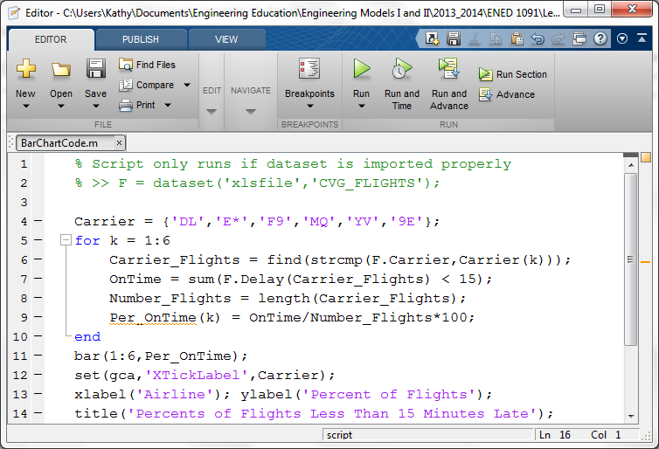
Happy Customers

Slide 24
Happy Customers

Slide 25
Delay Time vs. Date of Departure
Suppose we want to look at Delay Time vs Date of Departure for the carriers.
How do we deal with Date since it is a string?

Slide 26
Delay vs. Date of Departure
The departure dates are strings ‘11/22/2013’ thru ‘11/30/2013’. The function, datenum, in MATLAB will convert these string to numbers.
>> datenum('1/1/0000') % Day 1 according to MATLAB
ans = 1
>> datenum('11/22/2013')
ans = 735560
>> datenum('11/23/2013')
ans = 735561
>> datenum('11/30/2013')
ans =
735568

Slide 27
Delay vs. Date of Departure
>> gscatter(datenum(F.Date),F.Delay,F.Carrier);
>> ylim([-20, 600]);
Note:
The x-axis should be labeled with the dates not the numerical values from datenum

Slide 28
Delay vs. Date of Departure
>> cellstr(datestr(735560:735568))
% Converts Numbers Back to Cell Array of Dates
ans =
'22-Nov-2013'
'23-Nov-2013'
'24-Nov-2013'
'25-Nov-2013'
'26-Nov-2013'
'27-Nov-2013'
'28-Nov-2013'
'29-Nov-2013'
'30-Nov-2013'
>> gscatter(datenum(F.Date),F.Delay,F.Carrier);
>> set(gca,'XTick',[735560:735568]);
>> set(gca,'XTickLabel', cellstr(datestr(735560:735568)))
>> ylim([-20 600]); ylabel('Delay (minutes)');
>> title('Flight Departure Data CVG');

Slide 29
Delay vs. Date of Departure
Bad Days to Fly? Good Days to Fly?

